Slide 1


BATCH No. 18
Final Review
Dr. Mahalingam College of Engineering and Technology
Pollachi, Tamil Nadu, India
Department of Information Technology
19ITPN6801-Project (2021-2025 Batch)
A Machine Learning Approach to Parkinson’s Disease Detection Based on Mouse Interaction Pattern
Guided by
Submitted by
Ms. G.Keerthika
727621BIT038
727621BIT102
727622BIT315
Selvaragul M
Jaswanthan S
Srivishnu M
Assistant Professor
Information Technology
Tuesday, April 22 ,2025

Slide 2
OUTLINE
Project Title
Abstract
Literature review
Existing system
Drawbacks in Existing System
Proposed system and its advantages
Tool(s) used for implementation
Proposed Modules identification and description
Implementation work
Result
References
2
Tuesday, April 22 ,2025
A Machine Learning Approach to Parkinson’s Disease Detection Based on Mouse Interaction Pattern

Slide 3
A Machine Learning Approach to Parkinson’s Disease Detection Based on Mouse Interaction Pattern.
Project Title
3
Tuesday, April 22 ,2025
A Machine Learning Approach to Parkinson’s Disease Detection Based on Mouse Interaction Pattern

Slide 4
Abstract
A Parkinson’s Disease (PD) is a progressive neurodegenerative disorder that primarily affects motor control, leading to tremors, rigidity, and bradykinesia. Early detection plays a crucial role in effective management and treatment planning. Traditional diagnostic techniques often rely on subjective clinical evaluations, which can delay diagnosis in early stages. This project proposes an innovative, task-based approach to aid in the early detection of Parkinson’s Disease through the analysis of mouse movement patterns using a custom-built graphical interface. The system, developed using Python and Tkinter, incorporates three distinct motor tests—Follow Line, Draw Square, and Click Targets—each designed to assess different aspects of fine motor skills and coordination. By capturing and analysing metrics such as mean squared error (MSE), reaction time, and movement smoothness, the tool quantifies motor performance in a non-invasive and user-friendly manner. These metrics are then used to generate a risk score, which provides users with a visual risk assessment and personalized food recommendations based on their motor performance..
4
Tuesday, April 22 ,2025
A Machine Learning Approach to Parkinson’s Disease Detection Based on Mouse Interaction Pattern
Notes:
4

Slide 5
LITERATURE REVIEW
S.NO | TITLE | AUTHOR | YEAR | DISCRIPTION
1. | Parkinson's Disease Detection Using Mouse Movement Analysis and Machine Learning | W. Wang, J. Lee, F. Harrou, Y. Sun | 2020 | This study introduces deep learning techniques for early PD detection using premotor features such as REM sleep behavior disorder and olfactory loss. A comparison with traditional ML models demonstrated that deep learning achieved the highest accuracy of 96.45%
2. | Parkinson’s Disease Detection by Using the Machine Learning Method Based on Local Classification on Class Boundary | Q. Du, J.Shen, P.Wen, X.Chen | 2024 | This research explores machine learning for PD detection using speech signals, proposing a local classification approach that enhances accuracy while protecting patient privacy with Secure Two-Party Computing
3. | Parkinson’s Progression Markers Initiative (PPMI) Dataset | PPMI Consortium | Ongoing | A widely used dataset that provides clinical and imaging biomarkers for PD research, facilitating the development of machine learning models for early diagnosis.
5
Tuesday, April 22 ,2025
A Machine Learning Approach to Parkinson’s Disease Detection Based on Mouse Interaction Pattern

Slide 6
Existing System
In the traditional approach to diagnosing Parkinson’s Disease (PD), one of the most commonly used methods is hand-drawn spiral analysis. This involves asking the patient to draw a spiral on paper, which is then scanned or photographed and evaluated by a clinician for signs of tremors, irregular curvature, and inconsistent line spacing. These visual cues are indicative of fine motor impairments caused by PD. However, this technique is subjective, relies on expert evaluation, and lacks measurable, quantitative feedback. In contrast, our project proposes a modern, digital alternative by capturing similar motor skill indicators through mouse movement patterns. By integrating real-time tasks such as line following, square drawing, and target clicking within a graphical user interface (GUI), the system automatically records deviations, reaction times, and movement smoothness—offering a non-invasive, scalable, and objective solution for early PD detection.
.
6
Tuesdaysday, April 22 ,2025
A Machine Learning Approach to Parkinson’s Disease Detection Based on Mouse Interaction Pattern
Notes:
6

Slide 7
Drawbacks of Existing System
1.Lack of Quantitative Metrics: There are no measurable indicators such as reaction time, deviation values, or movement smoothness..
2.No Real-Time Feedback: Do not receive immediate results, leading to delays in diagnosis and follow-up interventions.
3.Poor Scalability: Since each test requires manual review, the method is not suitable for large-scale screening programs, especially in remote or resource-limited areas.
4.No Digital Integration: The system lacks the ability to store, analyze, or compare data digitally.
5. Data Collection : In spiral drawing conditions (e.g., paper quality, pen type, image clarity) can affect the accuracy and reliability of the assessment.
7
Tuessday, April 22 ,2025
A Machine Learning Approach to Parkinson’s Disease Detection Based on Mouse Interaction Pattern

Slide 8
Proposed System
Proposed System
The proposed system introduces an interactive, task-based Parkinson’s Disease (PD) detection tool that uses mouse movement patterns to evaluate motor skills and coordination. Built using Python and Tkinter, the system incorporates three key tasks - Follow Line, Draw Square, and Click Targets each designed to assess different aspects of motor control such as accuracy, smoothness, and reaction time. As the user performs these tasks, the system records real-time mouse data including coordinates, movement velocity, click events, and timing. From this, performance metrics such as Mean Squared Error (MSE), movement smoothness, and reaction time are calculated. These metrics are then analyzed to generate a Parkinson’s risk score that classifies the user as low, moderate, or high risk. Personalized health and food recommendations are provided based on the risk level.The system has also been designed to accommodate future integration with machine learning models such as SVM, Random Forest, or CNN for enhanced prediction accuracy. The modular architecture enables seamless data capture, analysis, visualization, and user feedback.
8
Tuesday, April 22 ,2025
A Machine Learning Approach to Parkinson’s Disease Detection Based on Mouse Interaction Pattern

Slide 9
Proposed System and its Advantages
Quantitative and Objective Evaluation
Low-Cost and Scalable
Early Detection Support
Low-Cost and Scalable
Machine Learning Ready
Personalized Recommendations
Visual Risk Reports
9
Tuesday, April 22 ,2025
A Machine Learning Approach to Parkinson’s Disease Detection Based on Mouse Interaction Pattern
Notes:
9

Slide 10
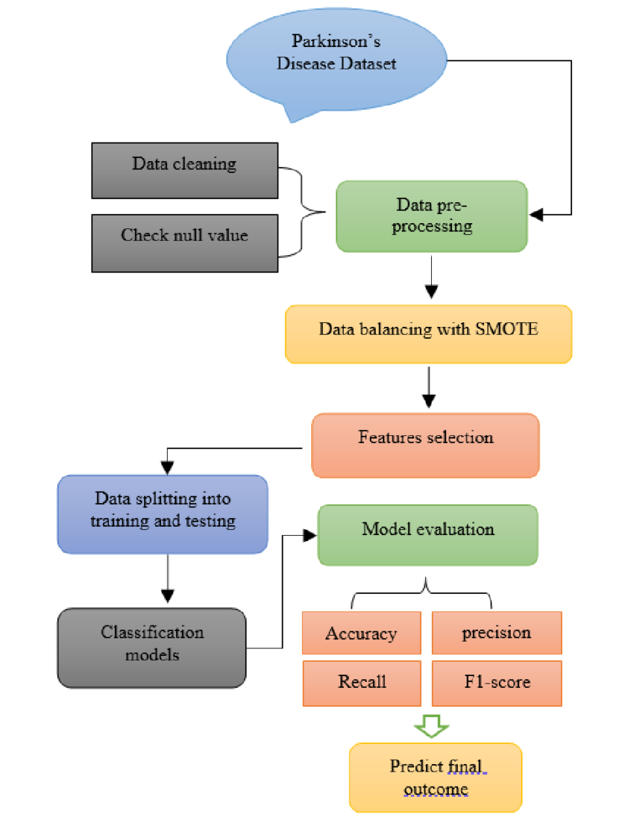
Flow Diagram
10
Tuesday, April 22 ,2025
A Machine Learning Approach to Parkinson’s Disease Detection Based on Mouse Interaction Pattern

Slide 11
Tools used for implementation
Software Requirements:
PROGRAMMING LANGUAGE : PYTHON
TOOL : PYCHARM
LIBRARIES/FRAMEWORK : NUMPY, PANDAS, SCIKITLEARN
Hardware Requirements:
PROCESS : Intel Core i7 (10th Gen) or AMD Ryzen 7+
RAM : 16 GB
HARD DISK : 1 TB
11
Tuesday, April 22 ,2025
A Machine Learning Approach to Parkinson’s Disease Detection Based on Mouse Interaction Pattern
Notes:
11

Slide 12
Proposed module identification and description
1.Mouse Tracker Module: Captures real-time mouse movement data. Tracks x-y coordinates, and movement direction.
2.Feature Extraction Module: Computes movement characteristics such as velocity, acceleration, direction changes, and stops. Filters noise from raw movement data for accuracy.
3.Data Preprocessing Module: Normalizes and scales movement data. Handles missing values and outlier better model performance.
4. Metric Computation and Analysis Module : To process the collected data and extract meaningful metrics.
5.Risk Scoring and Recommendation Engine : To evaluate the Parkinson’s Disease risk Score Low, Moderate and High
12
Tuesday, April 22 ,2025
A Machine Learning Approach to Parkinson’s Disease Detection Based on Mouse Interaction Pattern

Slide 13
Proposed module identification and description
6).Machine Learning Model Module:
Uses a trained Random Forest classifier to classify movement patterns. Optionally incorporates deep learning models for enhanced accuracy.
7).Prediction & Classification Module:
Analyzes new user data using the trained model. Generates probability scores and classification labels.
GUI Module Provides an interactive interface for users to start/stop movement tracking. Displays real-time classification results and confidence scores.
8).Model Evaluation Module:
Assesses model accuracy using test datasets. Computes evaluation metrics such as precision, recall, and F1-score.
13
Tuessday, April 22 ,2025
A Machine Learning Approach to Parkinson’s Disease Detection Based on Mouse Interaction Pattern

Slide 14
Dataset
Parkinson’s patients exhibit higher variability in velocity and acceleration due to tremors, leading to frequent, abrupt direction changes and increased movement stops compared to control individuals, who display smoother, more controlled movement patterns. The path length is often longer for Parkinson’s patients as their movement is more erratic, while control individuals follow shorter, more direct paths. Additionally, movement smoothness is significantly lower in Parkinson’s patients, with jerky, inconsistent motion, whereas control users maintain steady, fluid mouse movements. Timestamp-based analysis reveals frequent interruptions in Parkinson’s users' movements, contrasting with the continuous flow of healthy individuals. These differences in movement characteristics provide crucial features for accurately classifying Parkinson’s disease through machine learning.
Higher Velocity & Acceleration: Parkinson’s patients tend to show increased variability in movement. More Direction Changes & Stops: Unstable hand movements cause frequent stops and erratic movement. Path Length Differences: Control individuals may have smoother, more direct movements compared to Parkinson’s patients.
14
Tuesday, April 22 ,2025
A Machine Learning Approach to Parkinson’s Disease Detection Based on Mouse Interaction Pattern

Slide 15
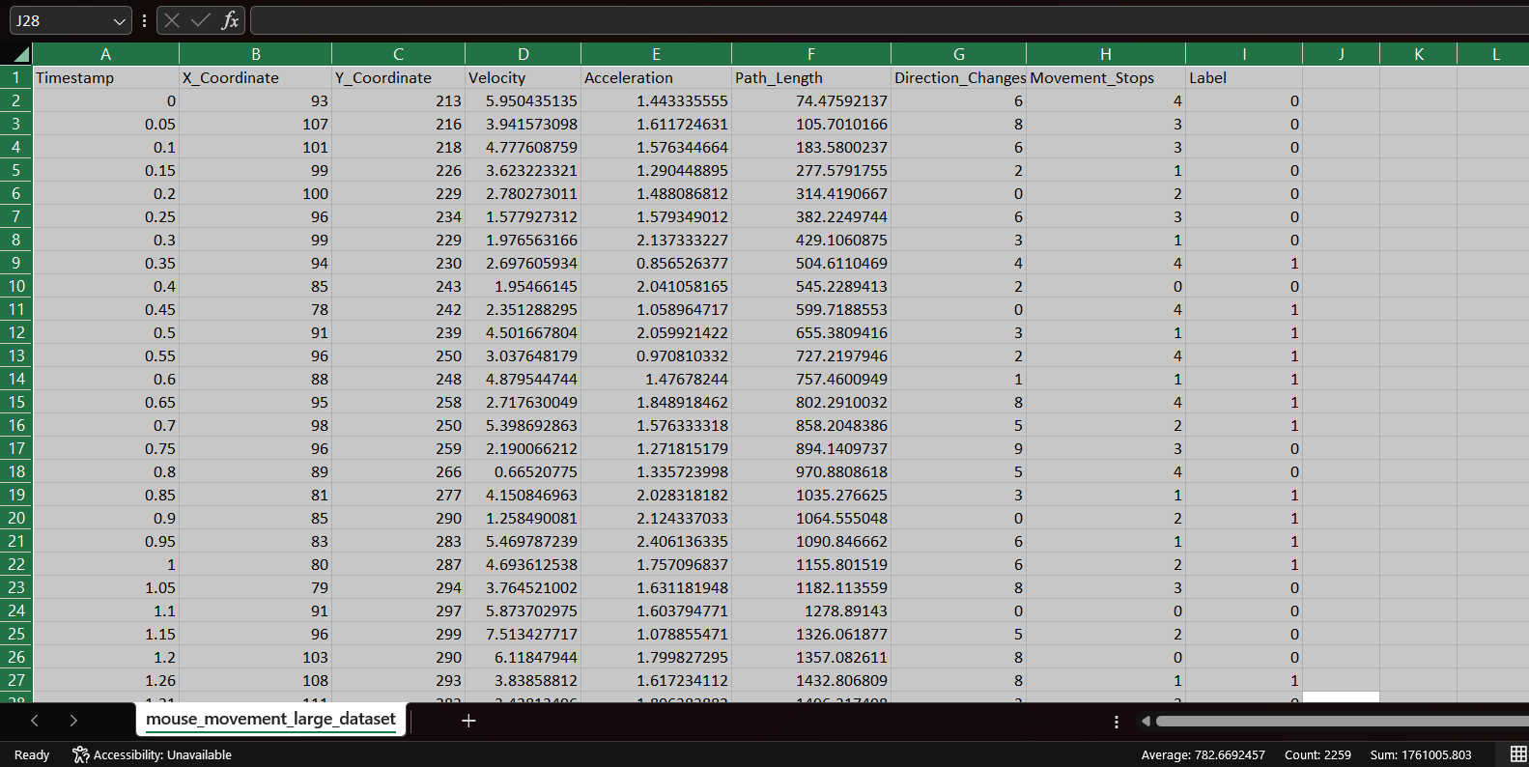
Dataset
15
Tuesday, April 22 ,2025
A Machine Learning Approach to Parkinson’s Disease Detection Based on Mouse Interaction Pattern

Slide 16
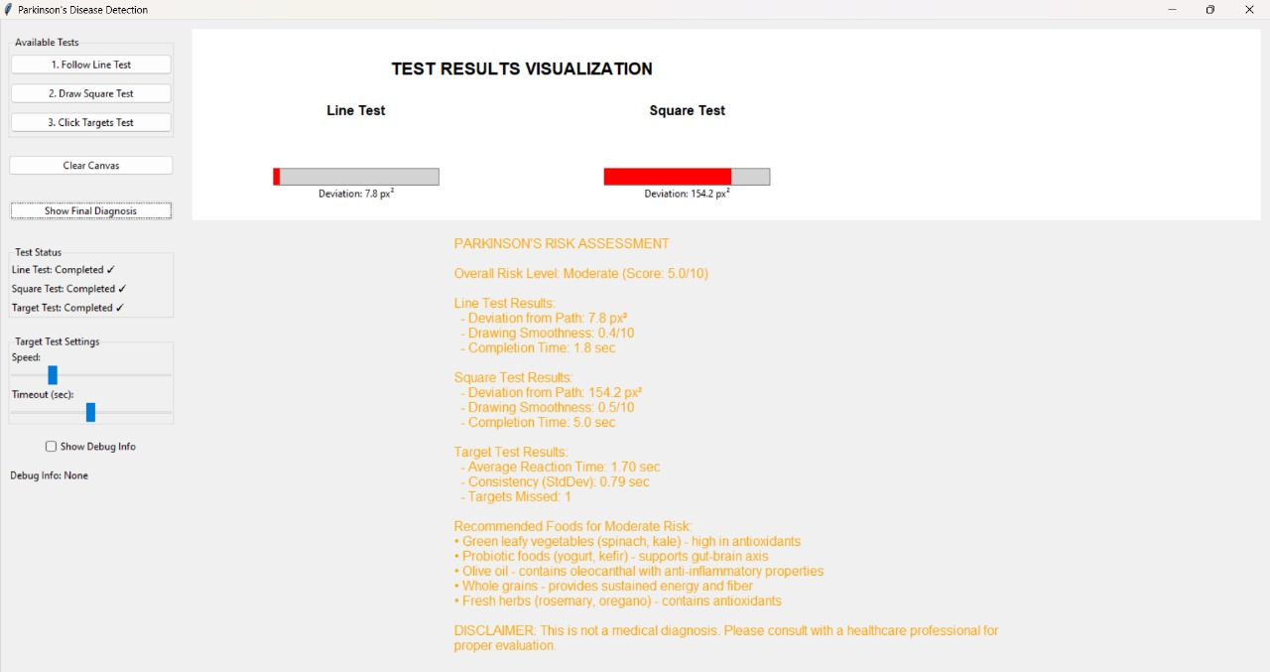
Result
Tuesday, April 22 ,2025
A Machine Learning Approach to Parkinson’s Disease Detection Based on Mouse Interaction Pattern

Slide 17
References
[1].Wang, W., Lee, J., Harrou, F., & Sun, Y. (2020).Early Detection of Parkinson’s Disease Using Deep Learning and Machine Learning. IEEE Access. DOI: 10.1109/ACCESS.2020.3016062
[2].Du, Q., Shen, J., Wen, P., & Chen, X. (2024).Parkinson’s Disease Detection Using Machine Learning Based on Local Classification on Class Boundary. Discover Applied Sciences. DOI: 10.1007/s42452-024-06295-1
[3].Drotár, P., Mekyska, J., Rektorová, I., Masarová, L., Smékal, Z., & Faundez-Zanuy, M. (2014). Decision Support Framework for Parkinson’s Disease Based on Handwriting and Speech Analysis. Biomedical Signal Processing and Control, 14, 11-18.
[4].Smits, E. J., Tolonen, A. J., Cluitmans, L., & Leenders, K. L. (2014). Assessment of Parkinson’s Disease Motor Symptoms Using Mouse Cursor Movements. Journal of Neuroscience Methods, 227, 35-42.
Tuesday, April 22, 2025
17
A Machine Learning Approach to Parkinson’s Disease Detection Based on Mouse Interaction Pattern

Slide 18
QUERIES?☺
18
Tuesday, April 22 ,2025
A Machine Learning Approach to Parkinson’s Disease Detection Based on Mouse Interaction Pattern

Slide 19

THANK YOU☺
Tuessday, April 22 ,2025
19
A Machine Learning Approach to Parkinson’s Disease Detection Based on Mouse Interaction Pattern

